Slide 1
HEALTH MANAGEMENT ORGANIZATION ANALYSIS
Final Project
IST 687
Group 5

Slide 2
PROJECT GOAL
The goal of the project is to provide actionable insights based on the available data and then accurately predict which customer will be expensive
This data is from HMO (Health Management Organization) health care cost information. The goal is to understand the main drivers that cause some people to spend more (need more health care), and then predict which people will have higher costs (health care costs).

Slide 3
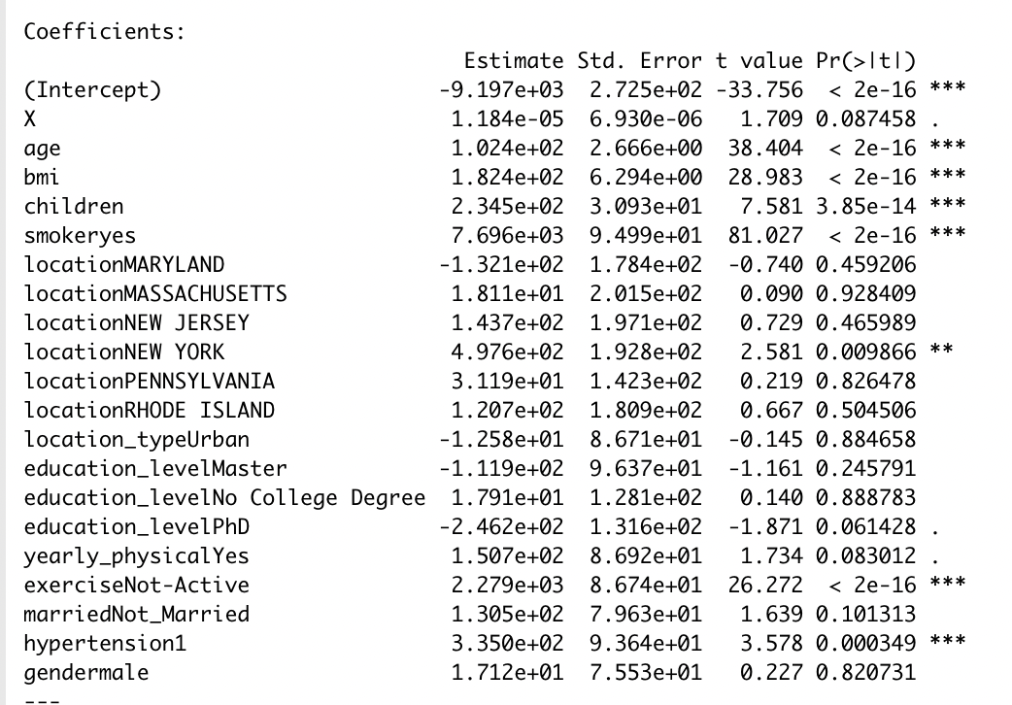
PROJECT FLOW
To see what variables were predictive of cost of healthcare, we ran a multiple linear regression with cost as the dependent variable, and all other variables as the predictors.
A few variables stand out as significant. A person’s age, bmi and number of children were the strong predictors of healthcare cost.
Being a smoker, living in New York, not exercising, and having hypertension were also all found to be significant predictors of cost of healthcare.
Each of these variables has a positive value for estimate, indicating they cause the price of healthcare to increase
These relationships are explored further in visualizations on following slides

Slide 4
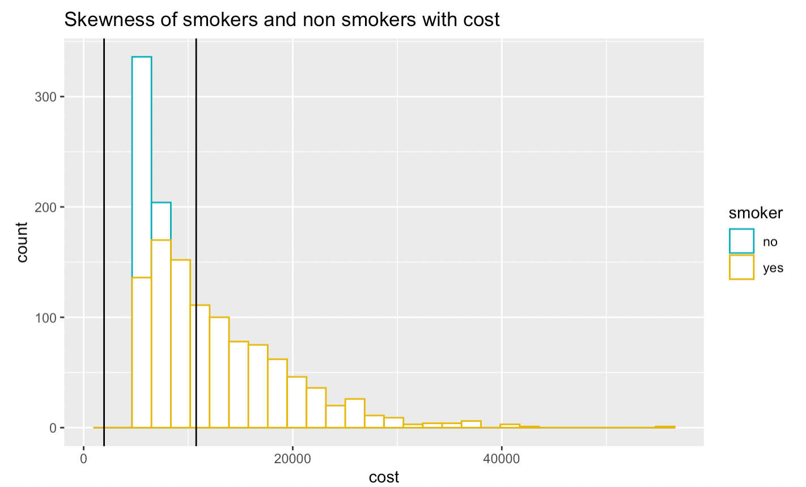
Those who smoke cost significantly more than those who don’t

Slide 5
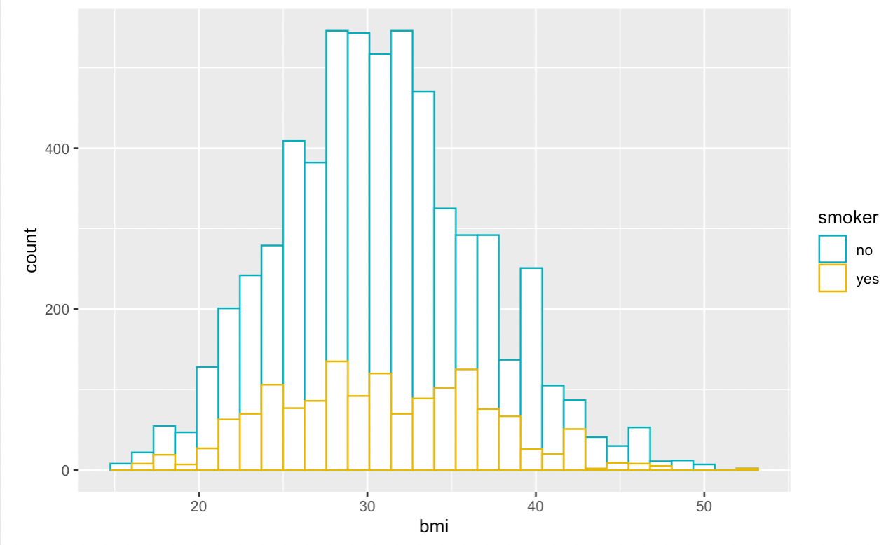
Those who smoke have no noticeable difference in BMI than non-smokers.

Slide 6
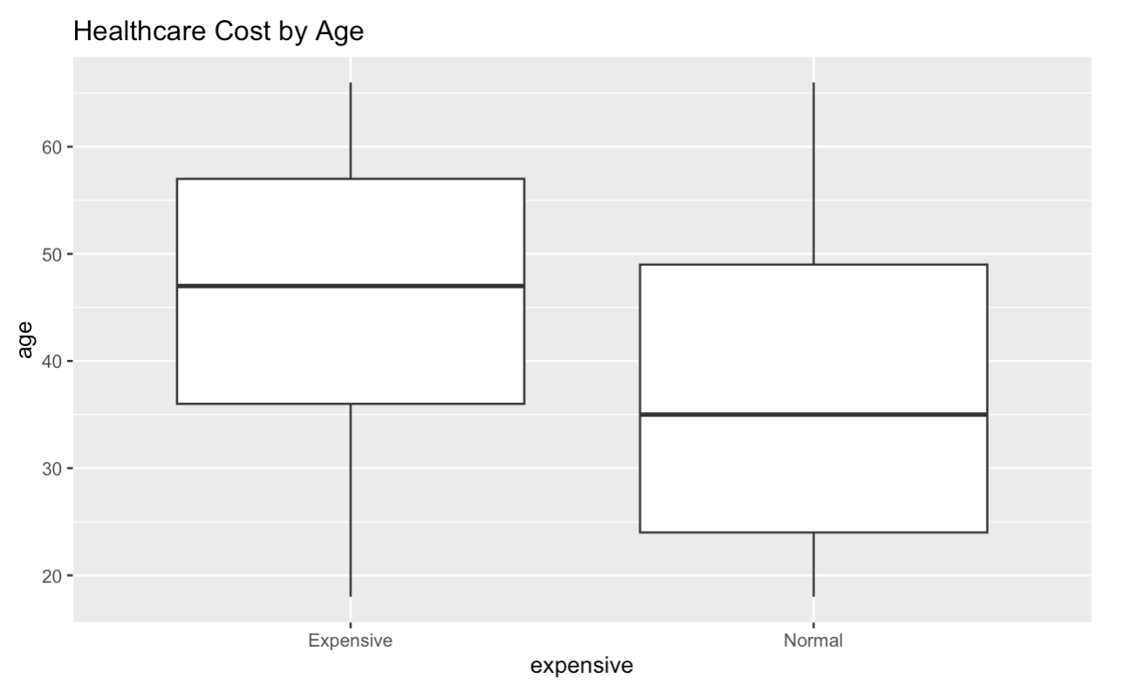
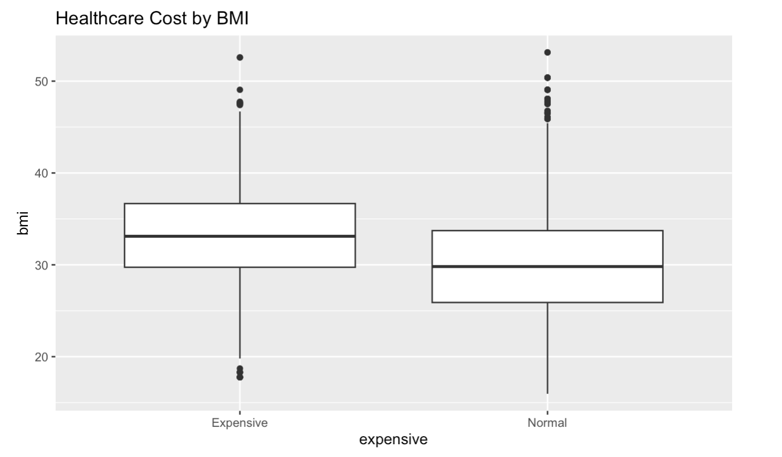

Slide 7
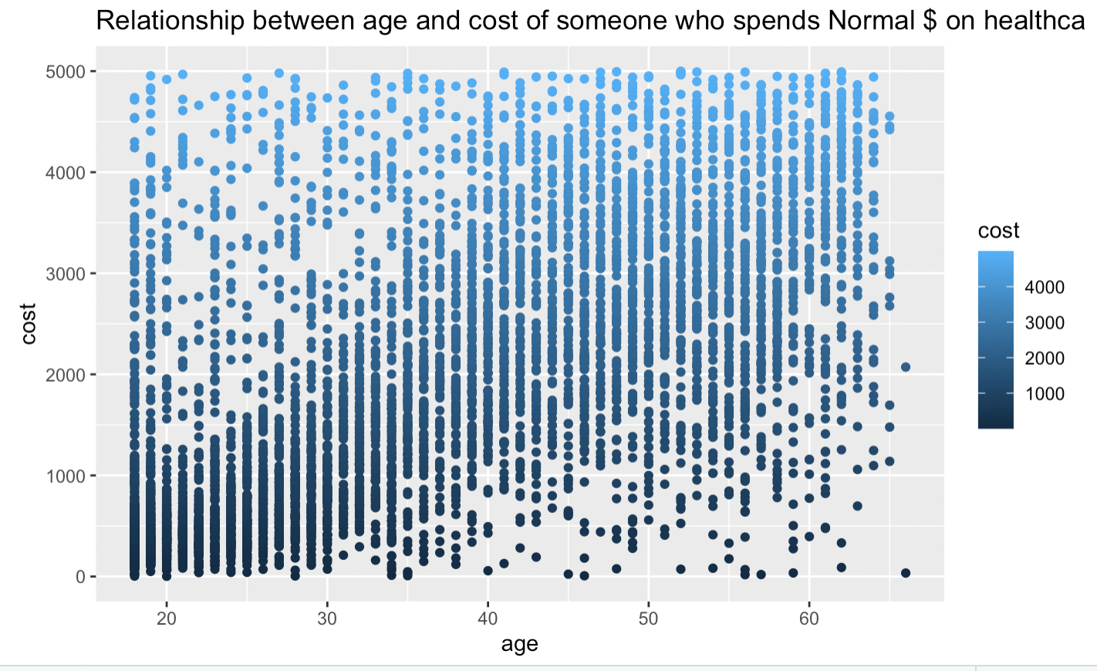
For those who cost a normal amount, there is a linear relationship between their cost and their age

Slide 8
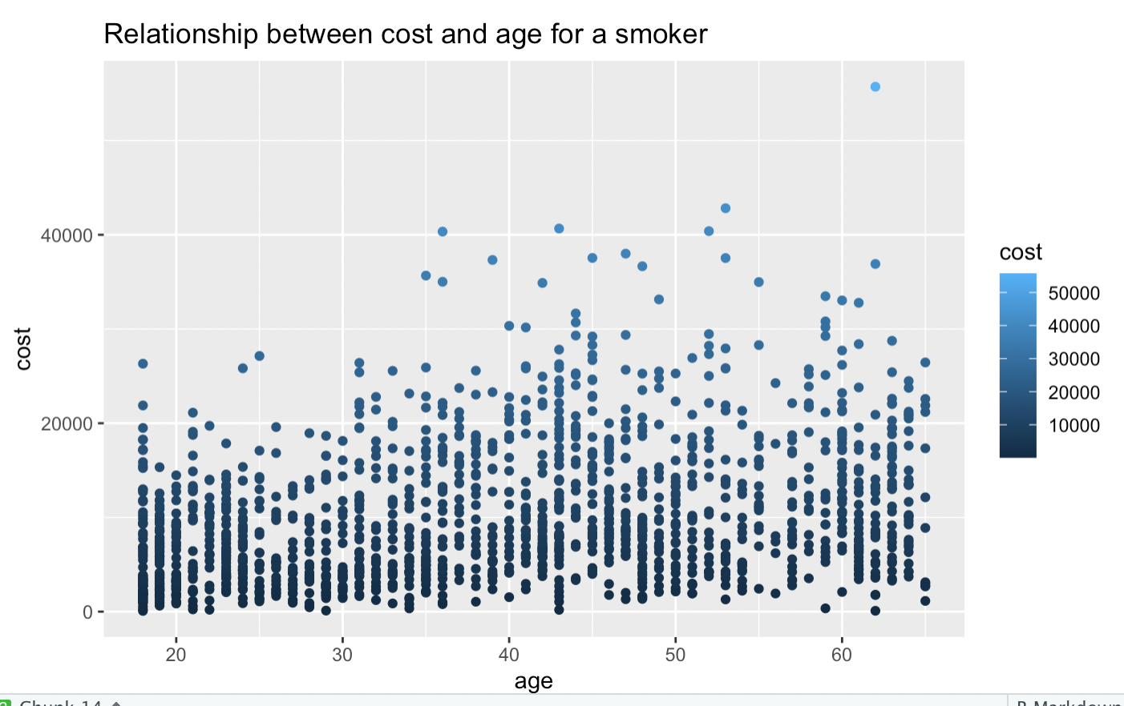
For those who smoke, there is no linear relationship between cost and age as they already cost significantly more, because they are smokers.

Slide 9
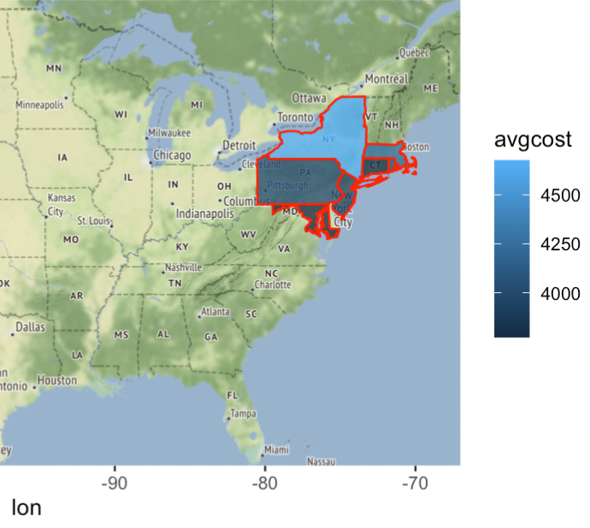
Map of Healthcare Cost by State

Slide 10
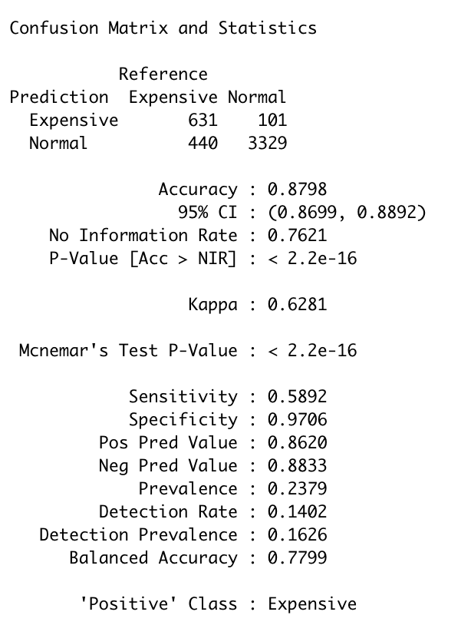
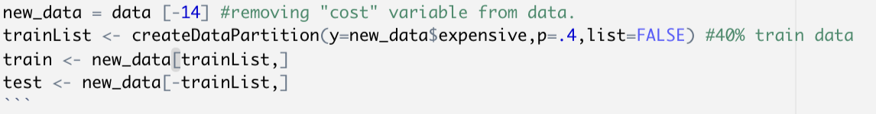
Support Vector Machine Model
The first classification model we chose was a SVM Model
Anyone in the dataset with a cost >= $5,000 was assigned the label “Expensive”
Everyone else assigned label “Normal”
Data was partitioned into training and test sets. After the model was trained the test data was used and referenced against the “Expensive” column to gauge accuracy
88% accurate and a Sensitivity of 58.9%

Slide 11
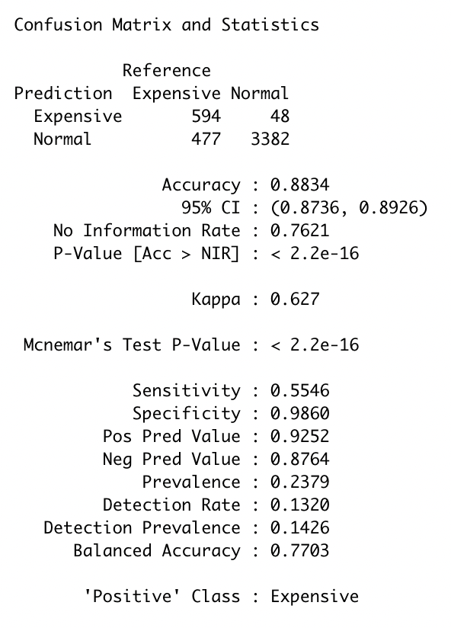
Rpart Model
We wanted to test additional model to compare the SVM model to
Rpart was trained and tested with same datasets as SVM.
Model was 88.3% accurate (very similar to SVM)
Model had sensitivity of 55.5%
This is ~3% points lower than the SVM model
Because we want to maximize sensitivity, SVM was chosen as superior model

Slide 12
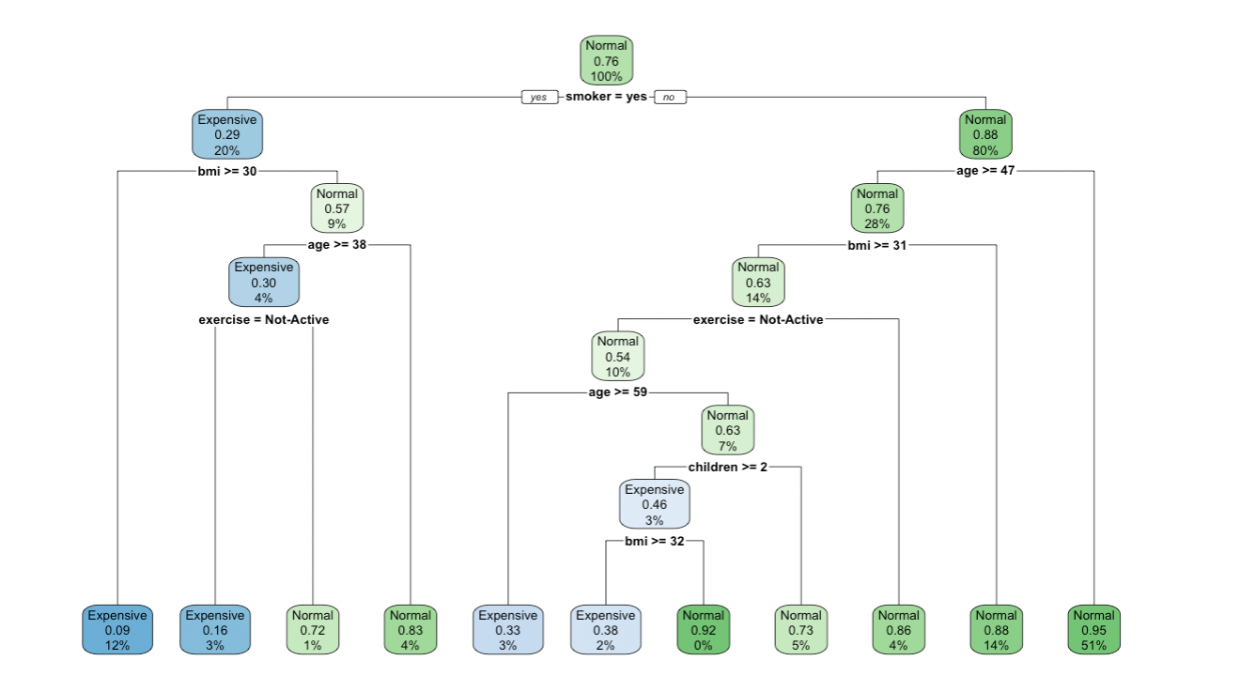
Rpart Tree
Insightful to look at Rpart Decision Tree. We can see the variables smoker, bmi, age, exercise, and children are included in the tree.
This supports findings from our linear model, which marked all of these variables as significant predictors of healthcare costs.

Slide 13
Shiny App
Link: https://damman267.shinyapps.io/Final_Project/

Slide 14
Our Recommendations
Based off of our analyses, we recommend three things to the HMO, with an emphasis on those who smoke.
Charge higher premiums to smokers. Since healthcare costs are much higher for smokers than non-smokers, retrospective of age, charging all smokers a higher premium would help balance out the high cost of healthcare.
If you are a smoker in New York, the premium should be even higher. New York was the only state that saw healthcare prices substantially higher than another state.
We also charge higher premium to older people, not because of their age but because bmi and age are related. As one grows older, bmi increases. Smoking has no effect on BMI.

Slide 15
Thank You
Questions?

